Slide 1

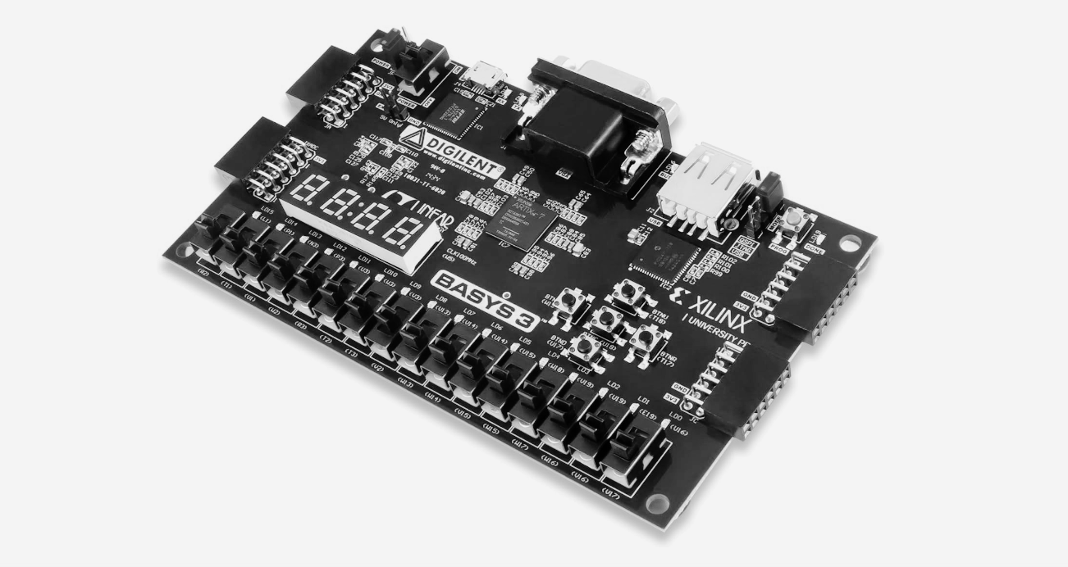


SPI
SPI
PROJECT

Slide 2

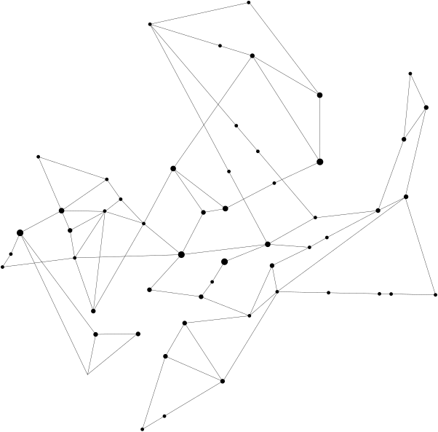




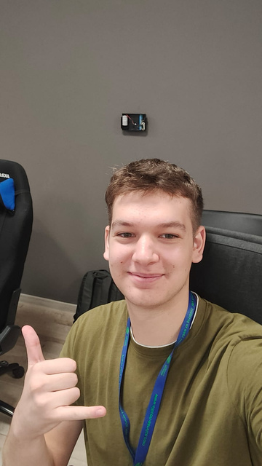

Silicon Service
Our team
Andrei Popa
Mădălina Mihălucă
Alexandru Antoci
Student
Student
Student

Slide 3


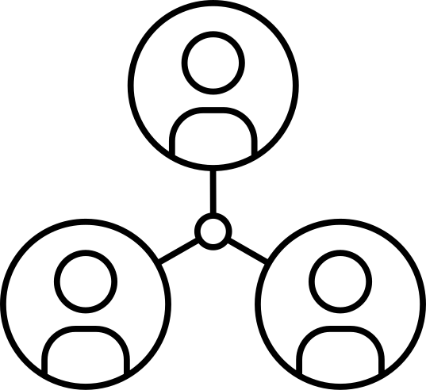

Table of Contents
What is a SPI
About Vivado
About Verilog
Vivado Workflow
Block Diagram
Block Diagram
Internal Structure
Simulation Waveform
Code
Bibliography
Internal Structure
Basys 3Board

Slide 4



WHAT IS A SPI?
SPI, or Serial Peripheral Interface, is a communication protocol used to transfer data between a microcontroller and peripheral devices. It enables fast, synchronous data exchange using four main signals:
MOSI (Master Out Slave In): Sends data from the master device to the slave.
MISO (Master In Slave Out): Sends data from the slave device back to the master.
SCK (Serial Clock): Provides the clock signal from the master to synchronize data transfer.
SS/CS (Slave Select/Chip Select): Selects the slave device that the master communicates with.

Slide 5

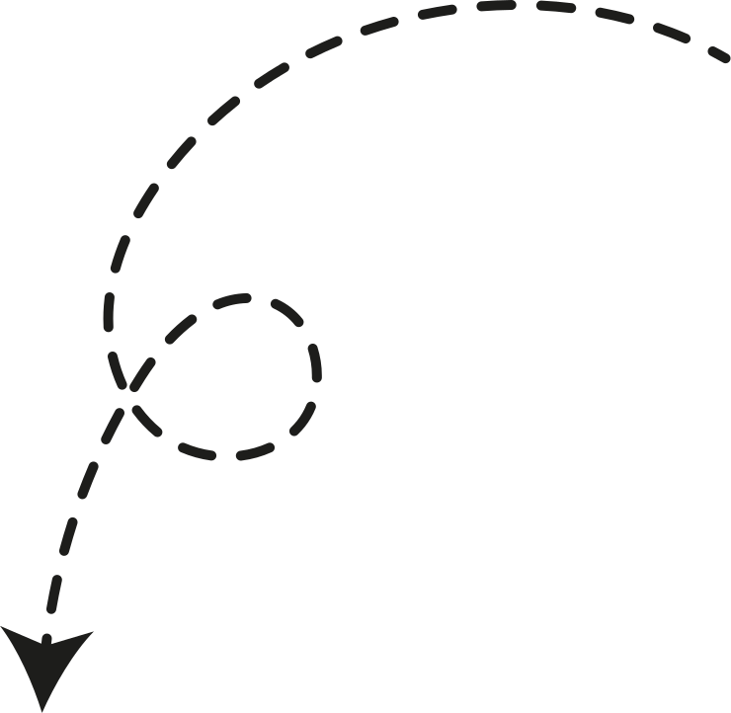
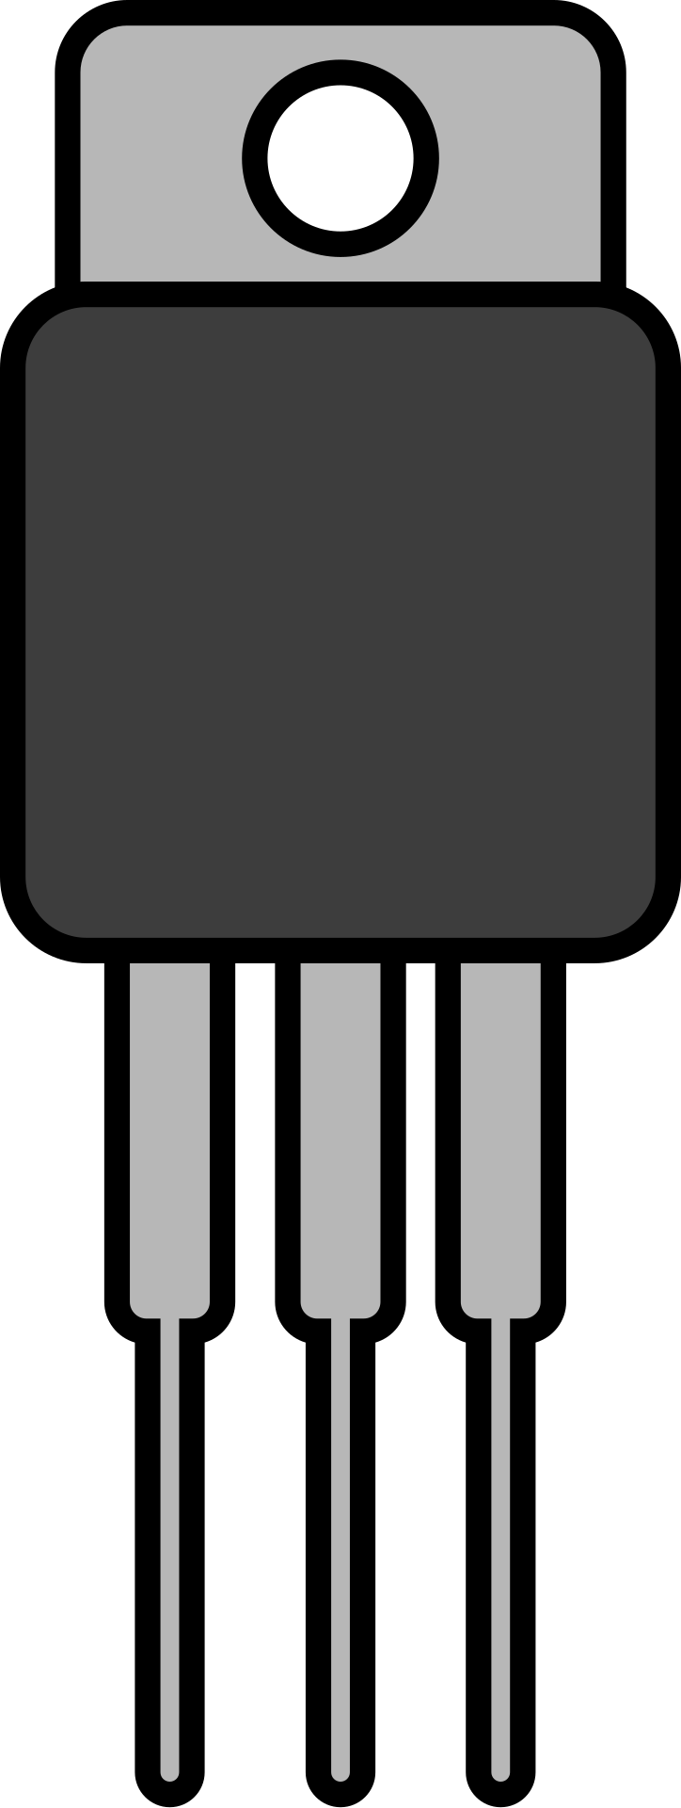
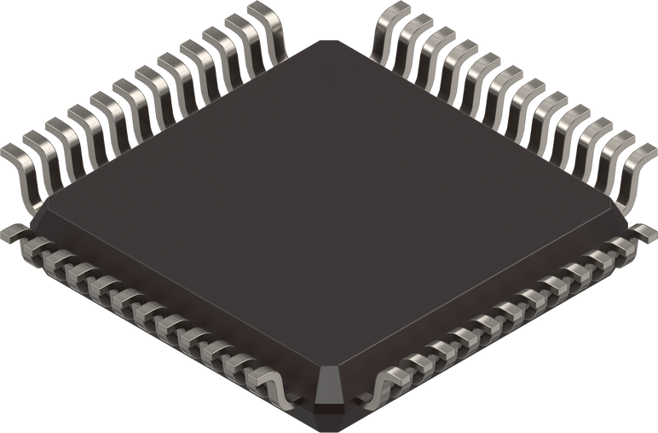
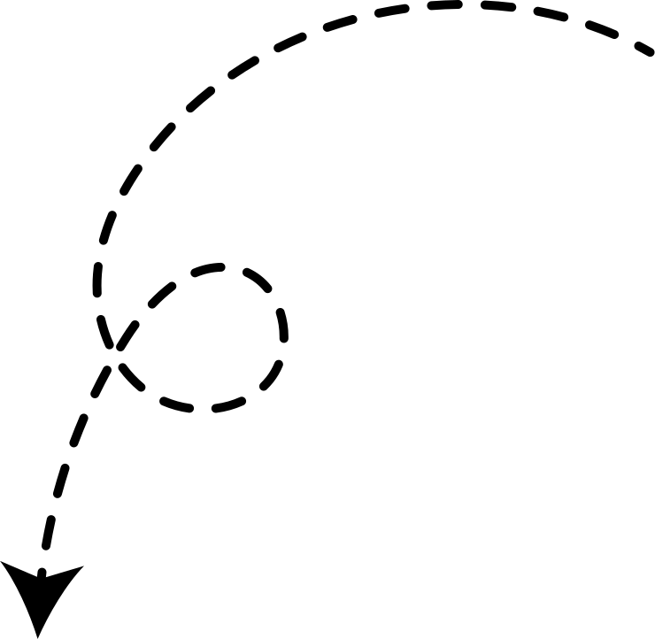
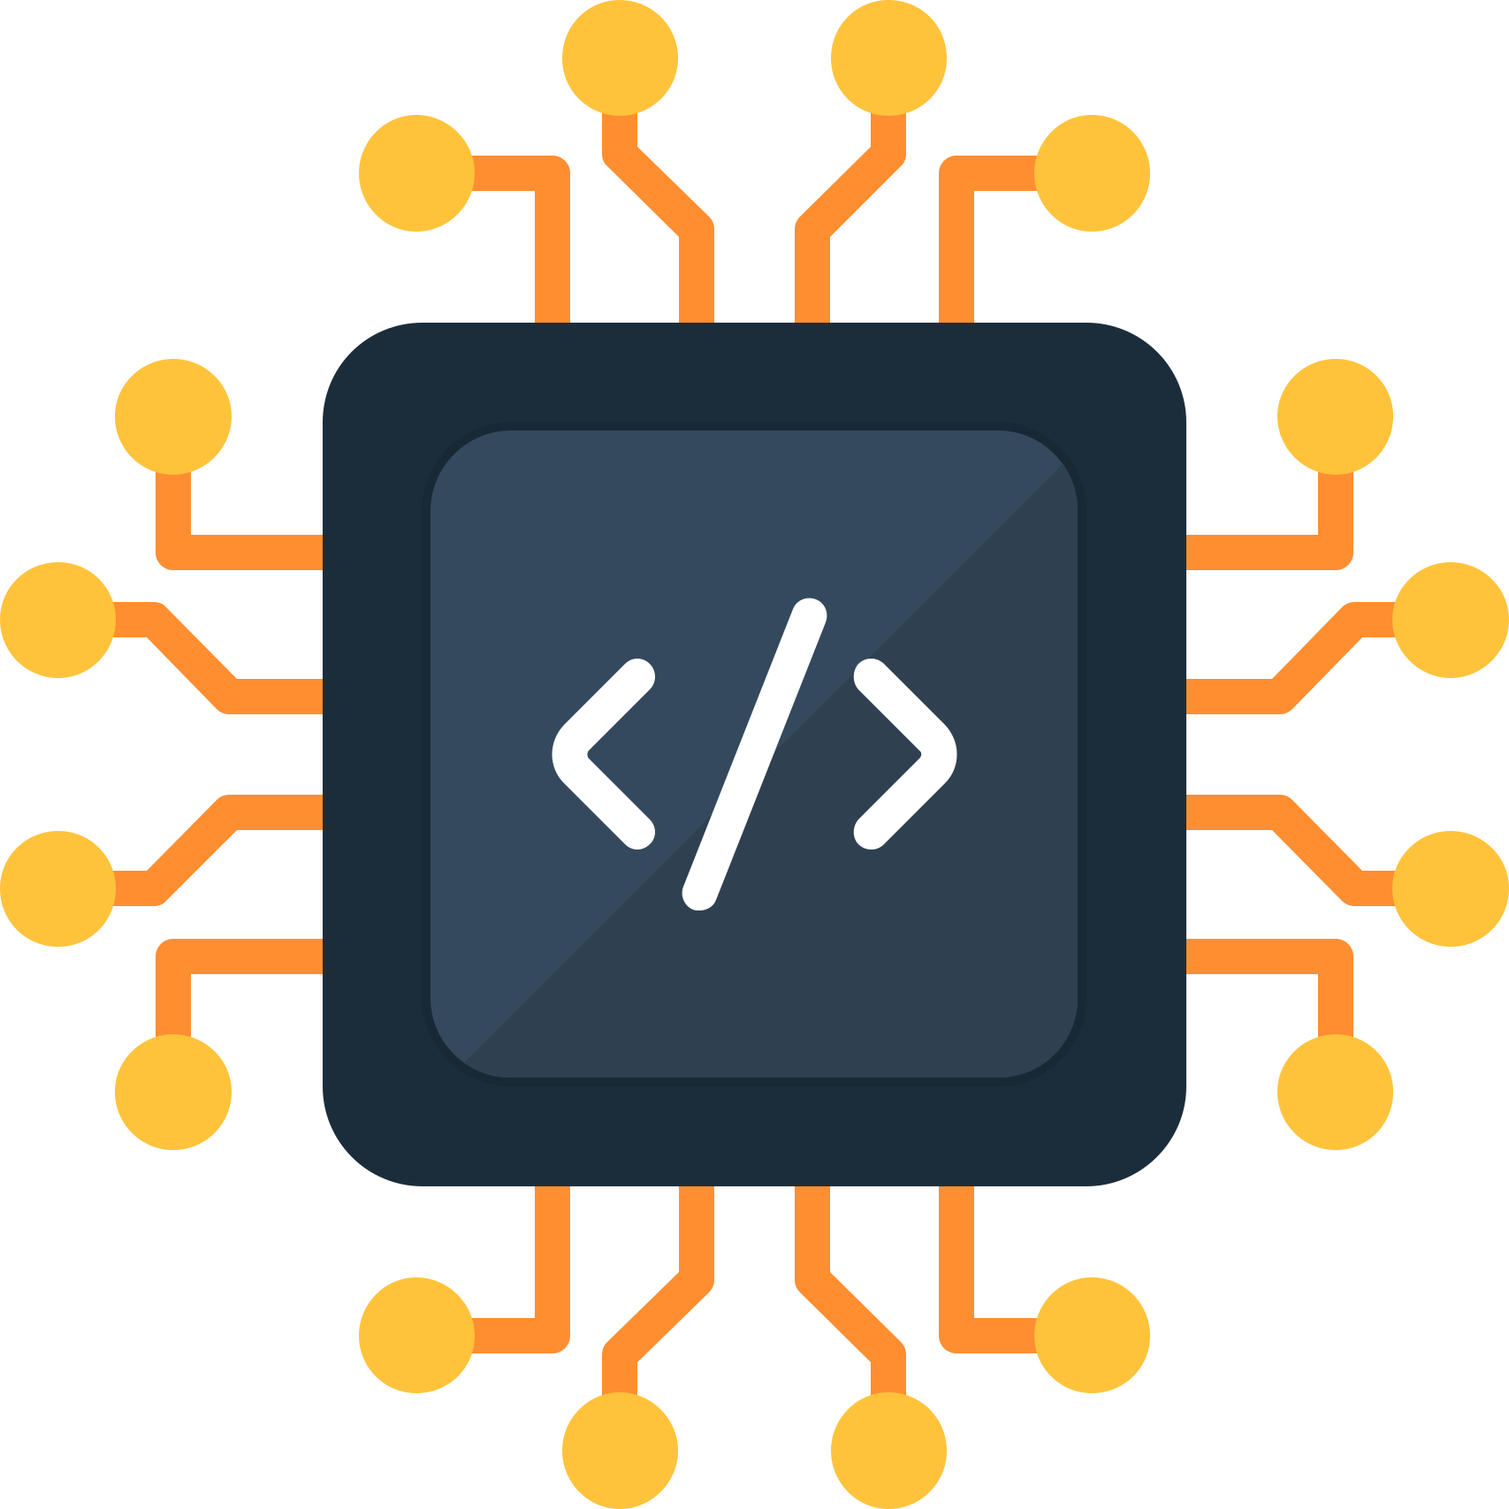
Real World Applications of
SPI
In Engineering

Slide 6

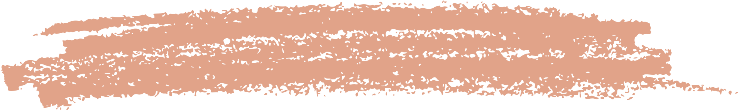
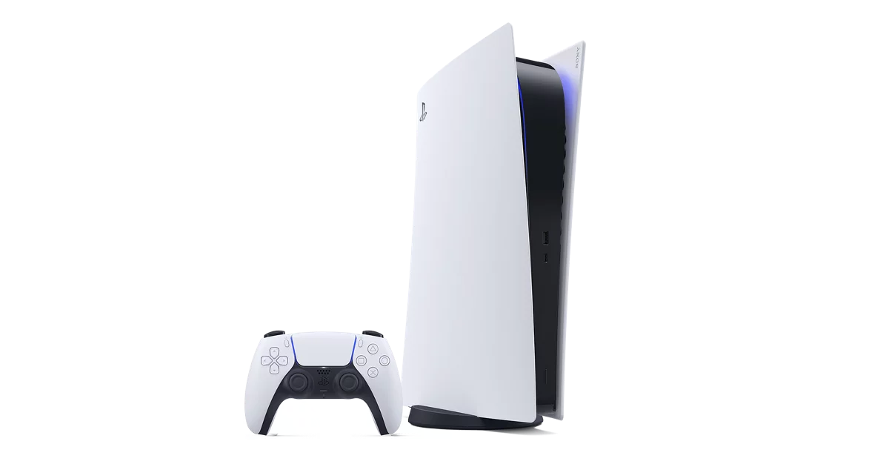

Smartphones
SPI is commonly used to connect the main processor with various peripherals such as touchscreens, fingerprint sensors, and memory modules.
Gaming consoles
The PlayStation 5's DualSense controller utilizes SPI to relay data from the controller to the console, enabling responsive haptic feedback and adaptive trigger functionalities.

Slide 7


Smart home Devices
Smart home devices also benefit from SPI's robust communication capabilities. Smart thermostats, security cameras, and home automation hubs often use SPI to facilitate communication between the central processor and various peripheral components.

Slide 8




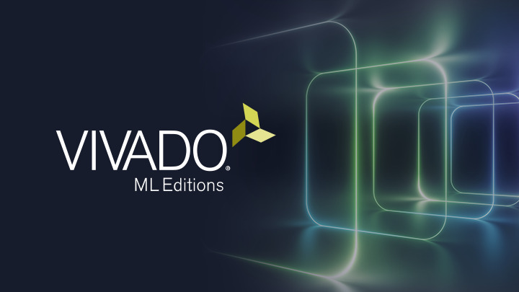

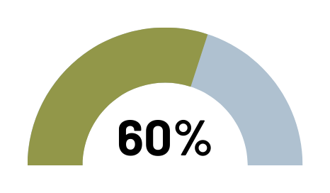
About
Vivado
Vivado is a software program developed by Xilinx for designing and programming programmable logic circuits, such as FPGAs. It is used by engineers to create, simulate, verify, and implement complex digital designs on hardware.
The main languages supported by Vivado are: VHDL, Verilog, SystemVerilog, C/C++.
Used for FPGA Design and Implementation
Used for Embeded Systems

Slide 9
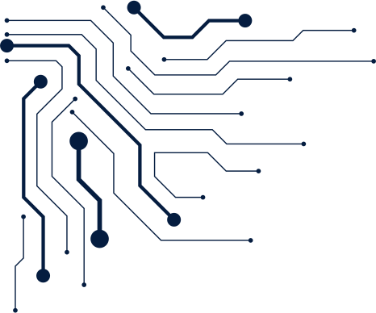
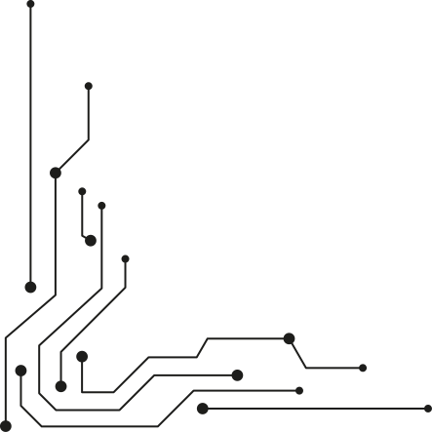
VIVADO WORKFLOW
Simulation means testing and verifying the digital design, without actually building the physical circuit, to ensure it functions as expected before its real-world implementation.
Simulation
Synthesis identifies synthesis errors and transforms the design described in a hardware description language into a concrete physical circuit. .
Synthesis
Implementation
This step includes placing and routing the circuit generated by synthesis, ensuring that the design aligns with the available hardware resources.
Generate Bitstream refers to the process of creating a bitstream file from a hardware design, which is then used to program a programmable logic device such as an FPGA.
Generate Bitstream
Open Hardware
manager
This step establishes the connection to the hardware resource, in our case, the Basys 3 FPGA.

Slide 10

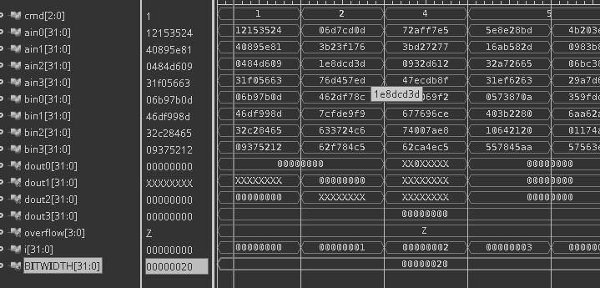
VERILOG
VERILOG
We have chosen to implement the project using the Verilog.
Verilog is a hardware description language used to model and simulate digital circuits. It is widely used in the development of integrated systems and FPGA design.
Verilog allows for the description of both the behavior and the structure of circuits, providing a way to describe and simulate the circuit before physically implementing it.

Slide 11

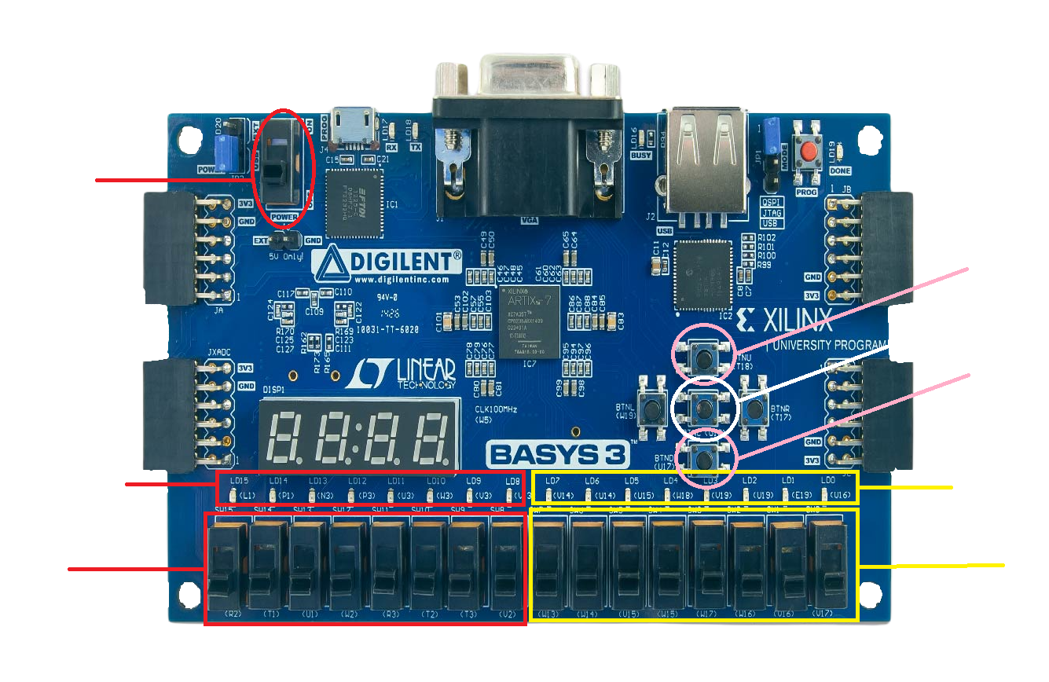
BASYS 3 BOARD
Power
Button
Ready
state
Reset
Pl
Data out
Slave
Data out
Master
Data in
Slave
Data in
Master

Slide 12
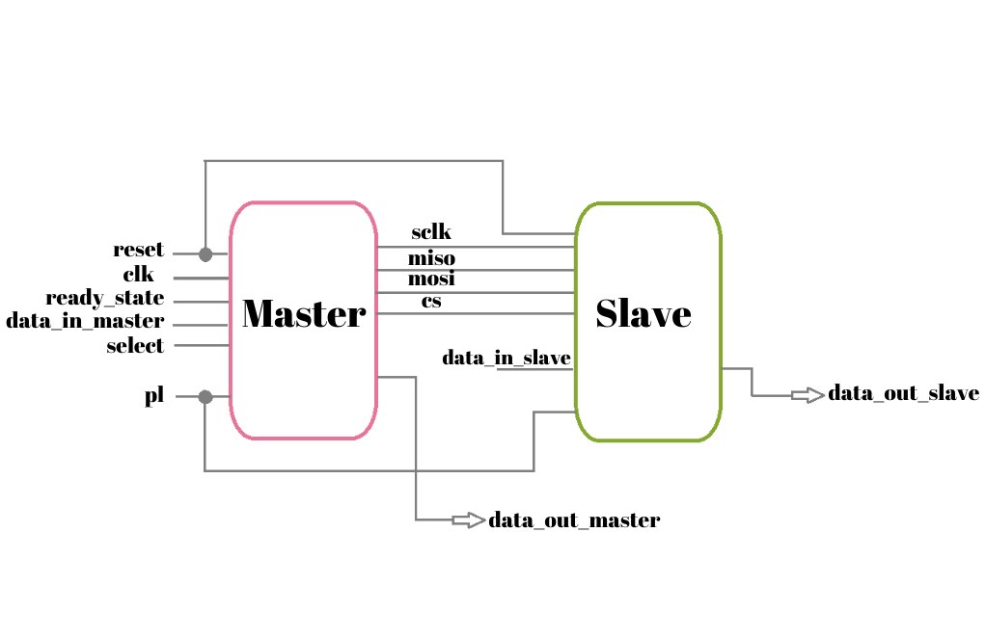



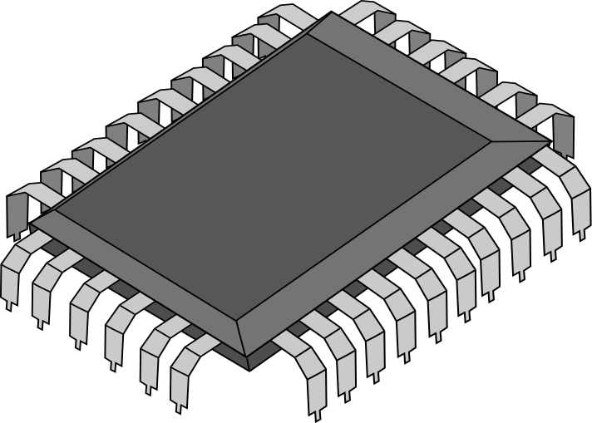
BLOCK DIAGRAM

Slide 13

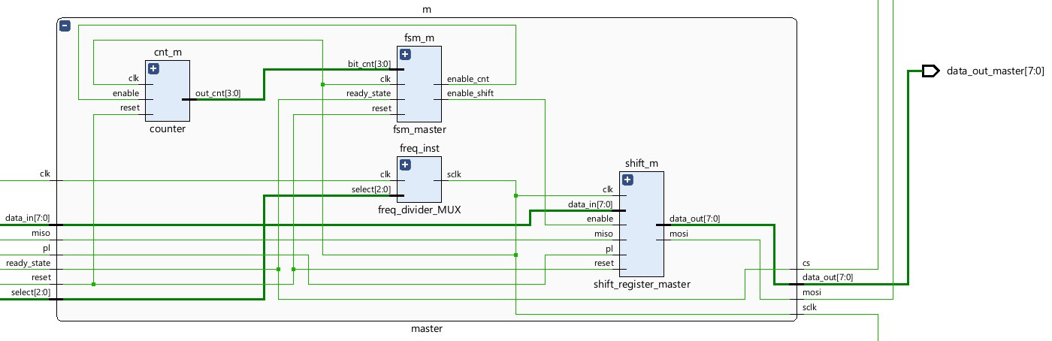
MASTER INTERNAL STRUCTURE

Slide 14
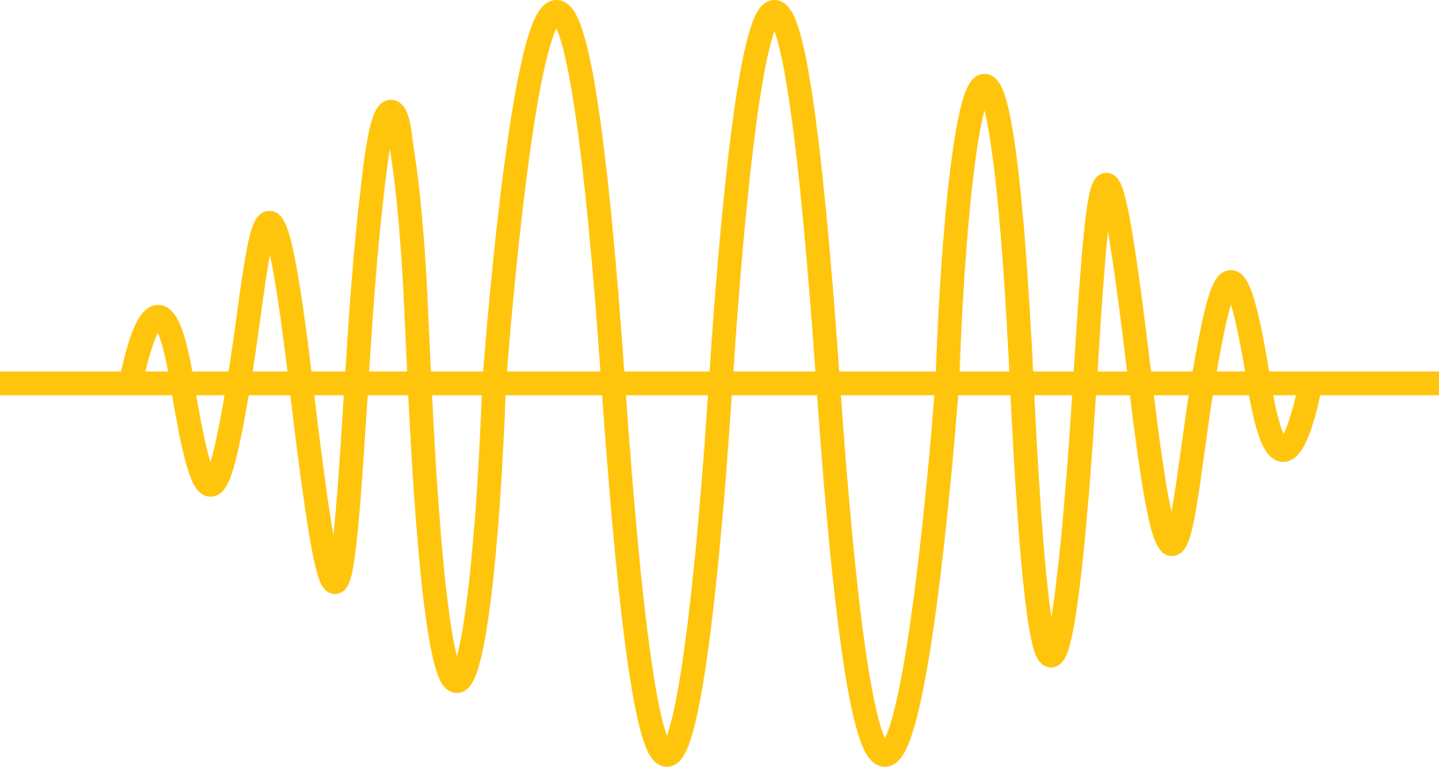
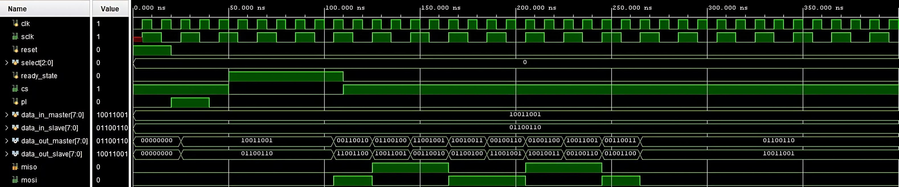
SIMULATION WAVEFORM

Slide 15
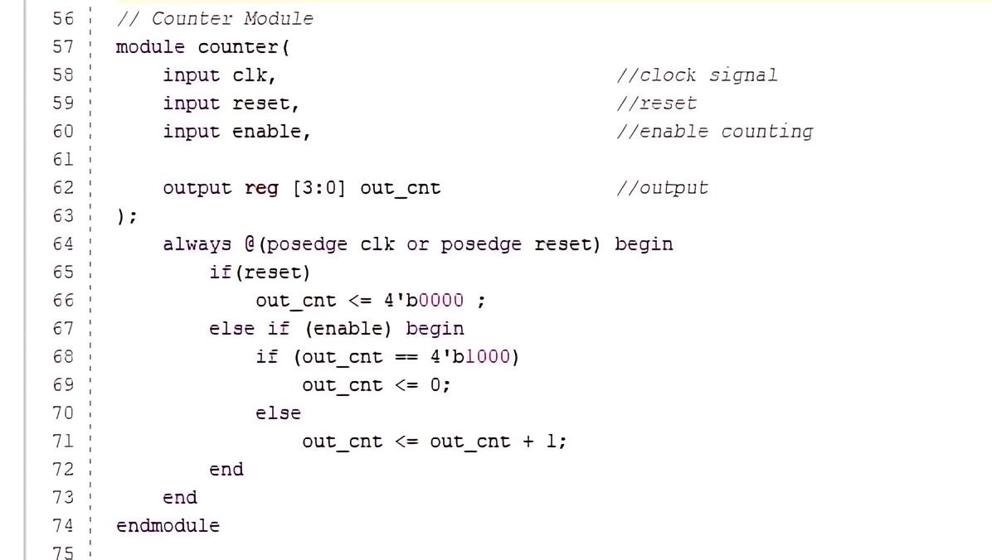

C
o
u
n
t
e
r

Slide 16
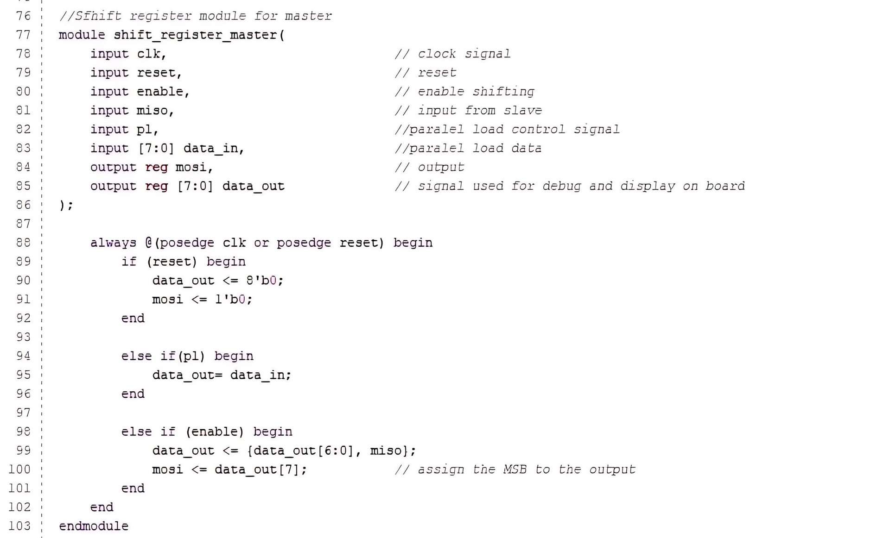


S
h
i
f
t
R
e
g
i
s
t
e
r

Slide 17
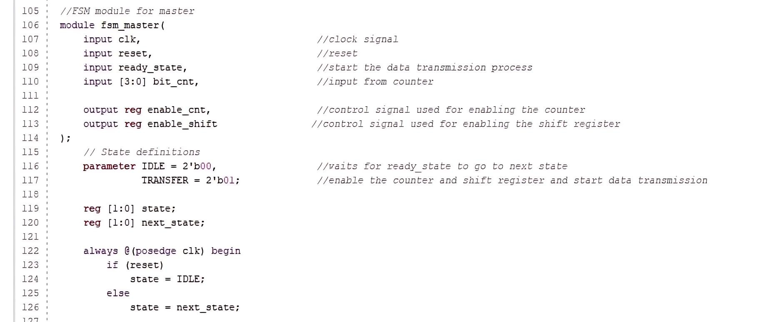
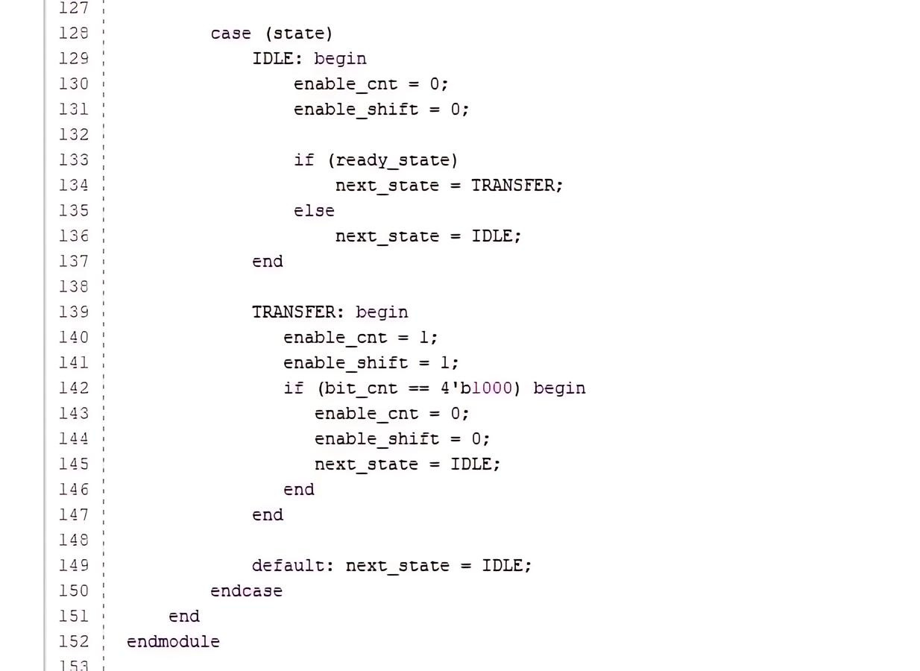
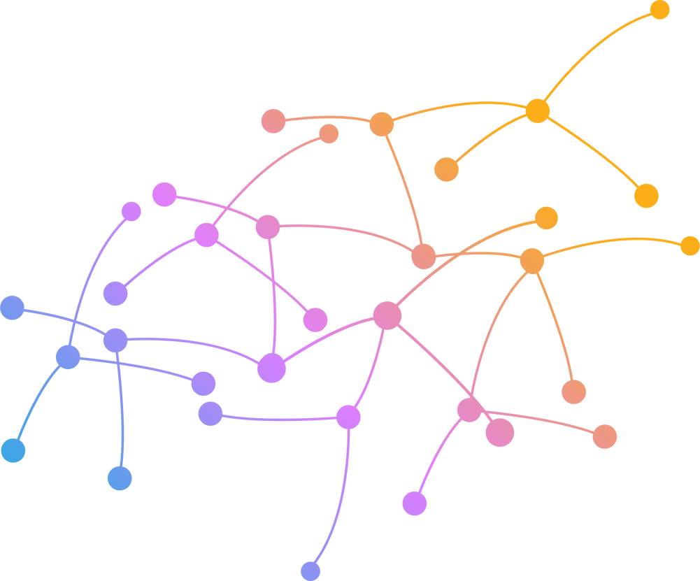
FSM
master

Slide 18

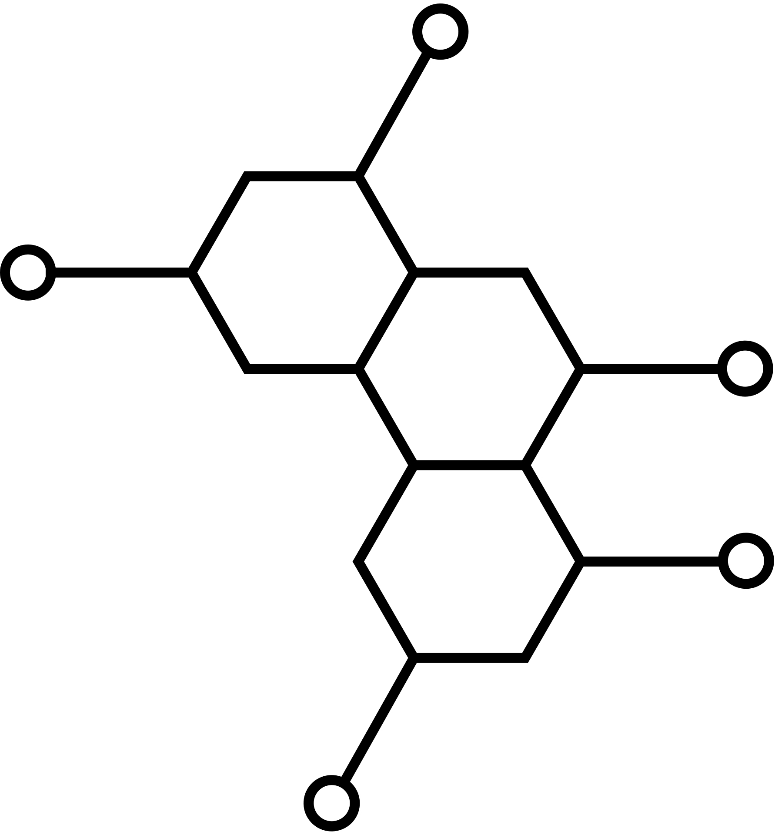
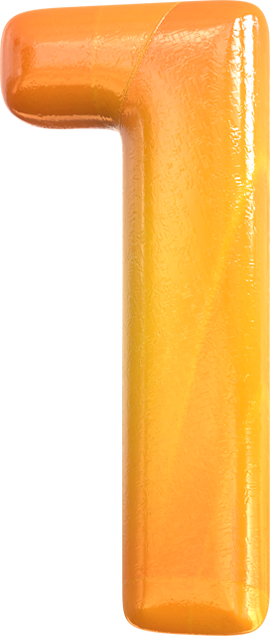
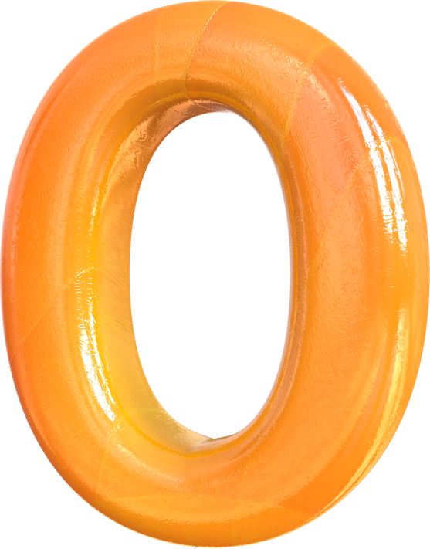
BIBLIOGRAPHY
https://forum.digikey.com/t/implementing-a-robust-microcontroller-to-fpga-spi-interface-part-2-protocol-definition
https://www.fpga4student.com/p/fpga-projects.html
https://www.xilinx.com/products/boards-and-kits/1-54wqge.html
https://chatgpt.com

Slide 19


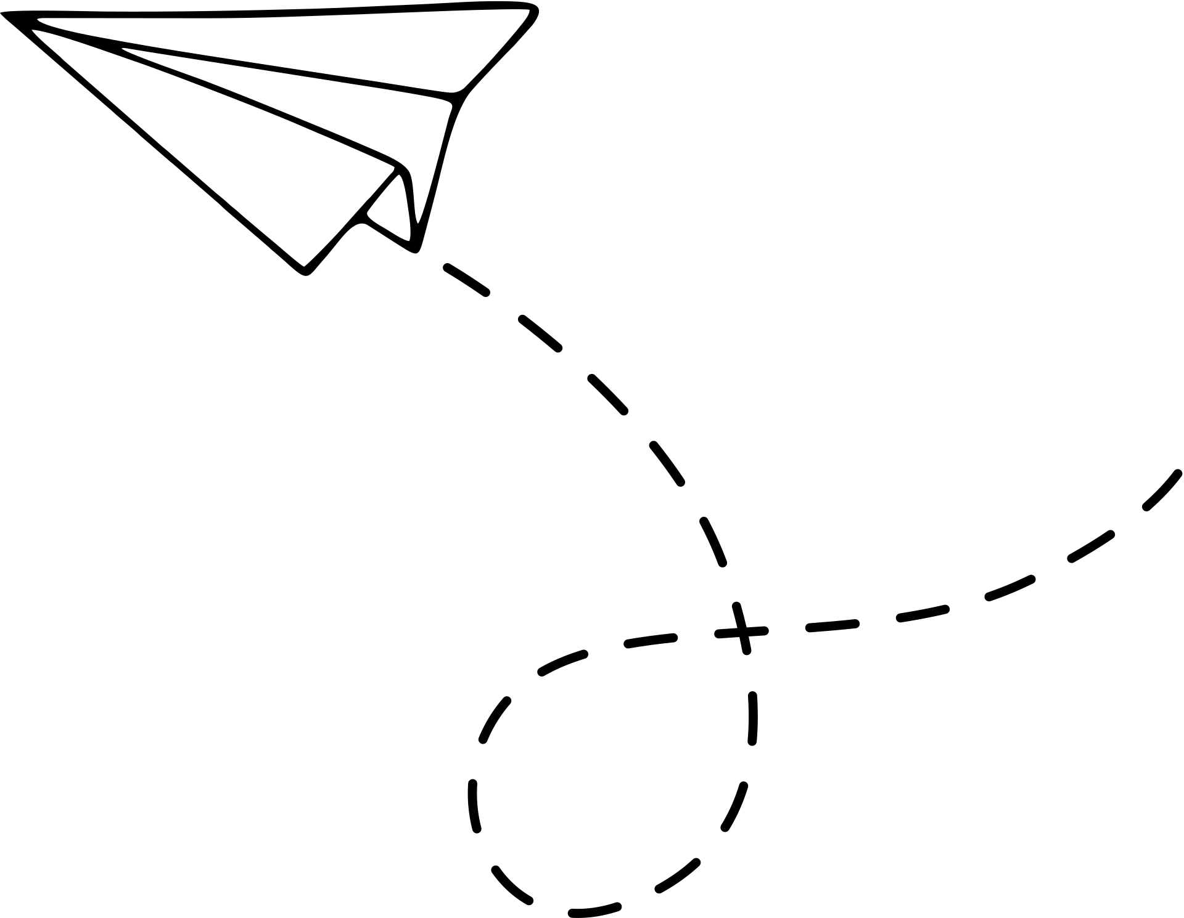





HANK YOU

